Slide 1
NVH Topic: Motor Noise – 2 Step Skew Magnet
2 Step Skew 36th order cogging cancelation will not meet customer requirement for NVH in PSA
Mainstream plan is for a 2 Step Skew Poled Shaped
Backup plan is 2 Step 5 degree Skew 18th order cogging. With canceling may allow for high Mz levels based on vehicle and structural response.

Slide 2
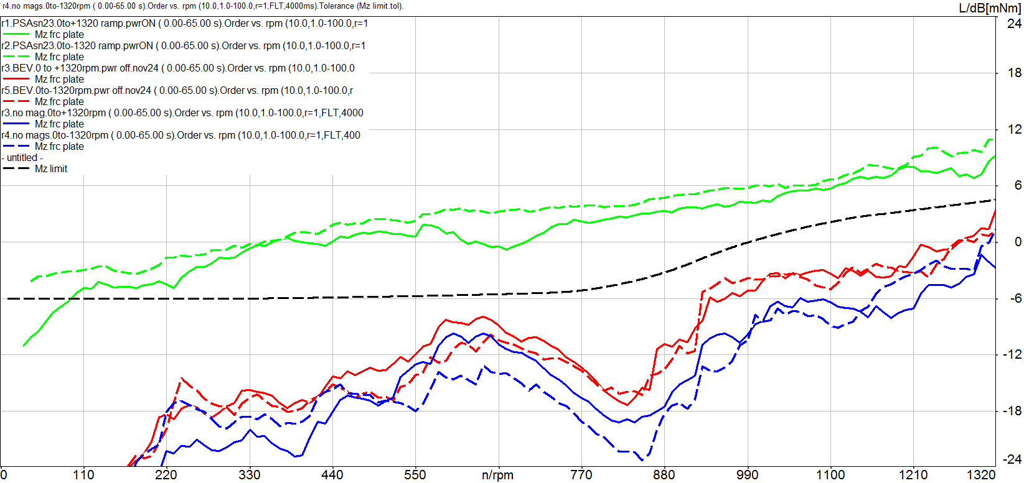
NVH Topic: Motor Noise – 2 Step Skewed Magnet PSA B618 Vehicle Testing
Cogging compensation for 2 step skew with r1=r2 motor is still unacceptable in PSA car in Saginaw.
GMUTS 6 (SAE 7) - wheels up, 0 assist, cog cancelation ON
Dominant part of annoyance confirmed to be 36th order
Variation in hand wheel speed produced a modulation of the noise as it passed through resonances increasing the annoyance
Green trace- SN023 with cog cancel
Red trace- BEV 3 step skew
Blue trace- 24mm No Magnets
Black trace- Proposed Mz limit
Solid is (+) dir, Dash is (-) dir looking into motor shaft
Mz

Slide 3
NVH Topic: Motor Noise – 2 Step Skewed Pole Shaped Magnet
2 Step Skew Pole Shaped rotors are being build into powerpacks and will go to vehicle before end of week. (21mm) Bench test cogging values look. (<2mNm)
If cogging noise performance with zero torque command looks good. Team will focus on developing TR cancelation algorithms to check powered noise performance.

Slide 4
NVH Topic: Motor Noise – 2 Step Skewed Magnet Variable Angle Skew Rotors Results
Variable angle skewed rotors test results are consistent with model results.
Benefits of 18th order cogging cancellation
Better resolution of controller/sensors for compensation (lower frequencies targeted)
For same HWRPM, the frequency content of 18th order is lower (more engine masking noise, ears are less sensitive – A weighting, and the radiation efficiency is usually less)
Higher HWRPM are required to excite the same resonances as 36th order (100 RPM vs. 50 RPM)

